Slide 1
Find Your Squad
By William Montague, Hamza Pereira, Jose Gallo, James Tcheng

Slide 2


Problem

Slide 3
Roommate matching is based on irrelevant information at CMU
What time do you go to bed (subject to change)
What time do you shower? (at least once a day)
Do you smoke? (Largely unhelpful)
From preliminary research on other universities:
Either completely random matching without any questions
Poor, insufficient matching similar to CMU
No matching at all!
Main issue: Can’t accurately assess someone personality

Slide 4

Solution:
An easy insight into your personality?
Voices

Slide 5
Voices are a window into someone’s personality
Article describes how hearing someone’s voice can bring a distant person back
Article voice matters more than the words actually being said
You cannot get this information from text alone
In theory, you can FaceTime potential roommates….
But there are hundreds of compatible matches!
It’s hard to do this with more than a handful of people

Slide 6
Our System
Cartesia for text-to-speech, clone voice; OpenAI for GPT-4o, Whisper (speech-to-text)
Upload yourself: collect a voice recording of at least 30s of you talking about yourself and what you’d like in a roommate →Whisper gets transcript→GPT-4o creates a persona GPT and Cartesia clones your voice
Meet other people: talk to other people’s persona GPTs that respond with their cloned voices
The persona GPTs have tuned hyperparameters based off of data.

Slide 7

Future Ambitions

Slide 8
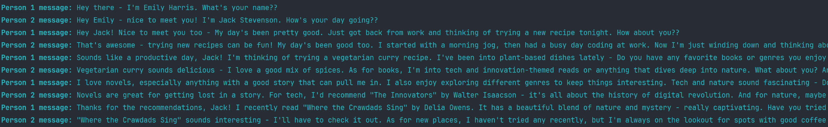
Fully-implemented computation of similarity metric
Emily and Jack seem to have a friendly conversation with shared interests in reading, nature, and exploring new experiences. However, potential issues could arise if they were roommates due Emily and Jack seem to have a friendly conversation with shared interests in reading, nature, and exploring new experiences. However, potential issues could arise if they were roommates due to differing lifestyle preferences. Compatibility score: 70.0

Slide 9
Using this technology on a dating app, where voice matters even more
Instant social media connection buttons
Not only a transcript, but an option to input more information about yourself, such as a mood board, a picture of your room, etc. Additional Option to upload an image of yourself
Drop-down list of potential roommates sorted by your similarity metric, with a search bar to find anyone. You can easily view reasons for the AIs choice of metric.

Slide 10
But most importantly…
Even more fine-tuning of the personality models
Engineering the prompt even more
Tuning further hyperparameters, such as the temperature of the model

Slide 11
Thank You!

